Slide 1
Version Control & GIT
Presented By:

Slide 2
$man git
NAME
git - the stupid content tracker
DESCRIPTION
GIT is a fast, scalable, distributed revision control system with an unusually rich command set that provides both high-level operations and full access to internals.

Slide 3
Applications
Why should I care?

Slide 4
CASE 1: The New Breaks The Old
Fixing a smaller problem breaks a significant feature.
Is there a backup of an older version?
Is the older version the most recent?
What work, if any, must be redone (lost productivity)?
What changed?
It follows that the incompatibility is a result of an interaction between the broken feature, and what changed.
This is why version control is important.

Slide 5
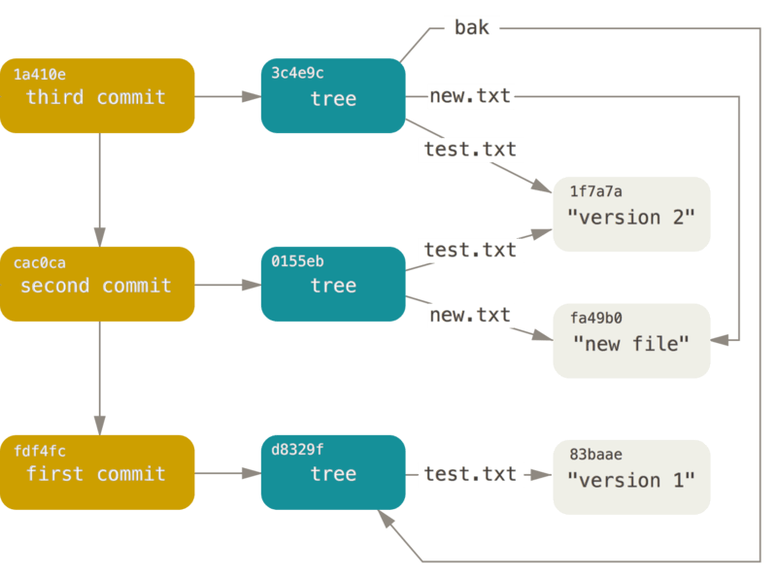
CASE 1: The New Breaks The Old

Slide 6
CASE 2: Multiple Team Members
Multiple individuals need to work on the same file.
Option A: Only one may work on the file at a time (Checkout Model).
Option B: Everyone gets a copy, but you must reconcile the differences.

Slide 7
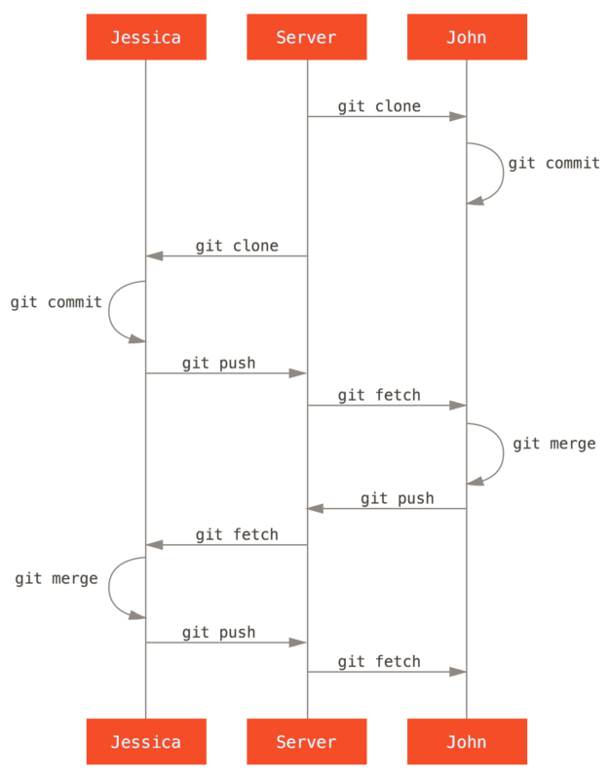
CASE 2: Multiple Team Members
GIT follows Option B.
Some overhead reconciling differences is created.
GIT’s model requires changes be made with respect the current version.
NOTE: This can be a problem if the version changes will submitting a commit. The process must be restarted.

Slide 8
CASE 3: Everything is Broke
Sometimes changes are made without regard to their adverse impacts on the project.
Commits track whom made the change.
“Diff” allows side-by-side comparison of versions logging additions, changes, and removals.

Slide 9
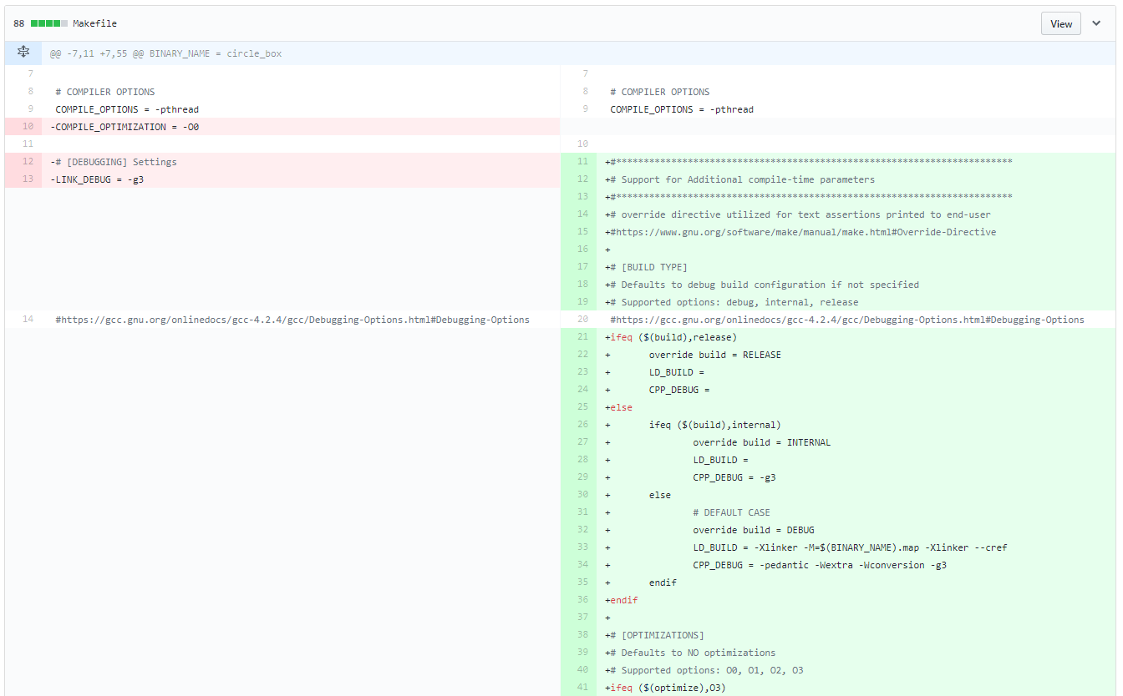
GitHub (3rd Party) Implementation of Diff

Slide 10
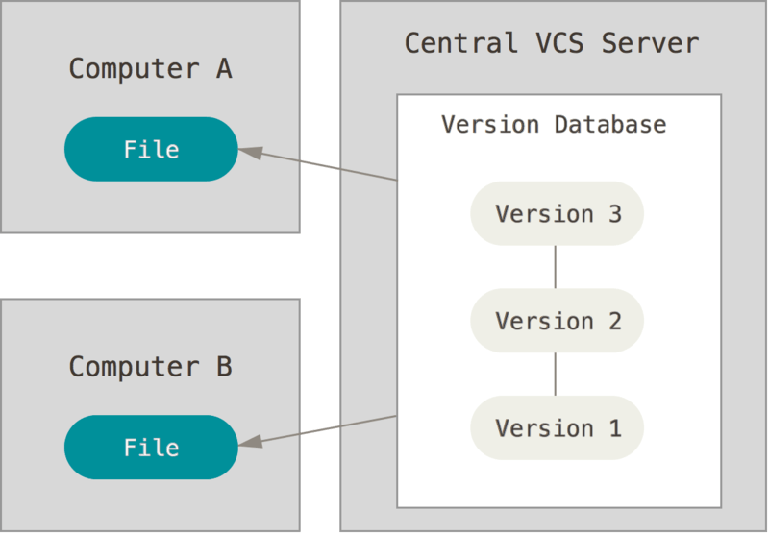
CASE 4: The Internet SUX
Centralized Version Control
The user has copies of selected files.
The repository only exists on the server
Apache Subversion (SVN) uses this model.

Slide 11
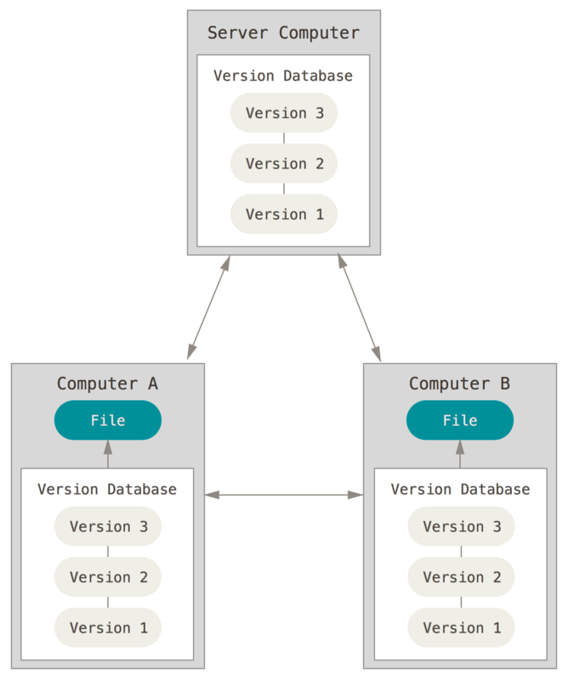
CASE 4: The Internet SUX
Distributed Version Control
The user may “clone” a repository.
The user’s local copy is a version complete copy.
GIT uses this model.

Slide 12
Theory (Simplified)
A Simplified Summary of Commit, Branches, and Merging

Slide 13
Commits
Initial Commit
Version B
Version A
Final Version
Commits
Represented as circles on a tree graph.
Symbolize an instance (version) of a project’s files.
Can add, remove, or modify a file (or multiple files).
Desirable Features:
Copy on Write- Only save the changes. Unmodified content is implicitly imported from the previous commit.

Slide 14
Branches
Main (Trunk):
Development:
Feature A:
Branch
A branch is a distinct variant of the project base.
Branches allow isolated environments for working on new features and fixes without disrupting the project.
Branches are created by “forking” from either the main branch (Trunk) or another branch.

Slide 15
Merging
Main (Trunk):
Development:
Feature A:
Merge
A branch may be merged into another.
The branch creates a “pull request” requesting that its present version be merged into another. The requestor details how to make the changes.
An authority from the branch being merged into then is expected to review the request.

Slide 16
Additional References
GIT SCM (Official Site)
https://git-scm.com/
git - the simple guide
https://rogerdudler.github.io/git-guide/
GitHub GIT CHEAT SHEET
https://services.github.com/on-demand/downloads/github-git-cheat-sheet.pdf

Slide 17
Citations
Figures from the CASE section: ProGit 2nd Edition (2014) by Scott Chacon and Ben Straub released under a CC NC SA license.
GitHub Diff from GitHub.com

